Slide 1


Donaldson Sentiment Analysis Project
Team: Bob Cats

Slide 2

Team: Bob Cats
Mengyi Tao —— Project Manager + Data Analyst
tao.men@northeastern.edu
Zining Tan —— Data Analyst
tan.zi@northeastern.edu
Meiling Zeng —— Data Analyst
zeng.mei@northeastern.edu
Jiaqi Shen —— Data Analyst
shen.jiaqi1@northeastern.edu

Slide 3
Table of Contents
Introduction & Project Goals
Analysing Tools: NLP & Sentiment Analysis
Data Collecting: YouTube Data API
Data Cleaning
Data Analysis: Sentiment Analysis
Data Modeling
Data Visualization
Conclusions & Suggestions
Weaknesses

Slide 4
Chapter 1
Project Overview

Slide 5


Project Overview
Objectives
Helps Donaldson understand how the global market views different powertrains systems today
Uses a data perspective to understand which powertrains - battery electric, hydrogen fuel cell, or any other technology - will gain the largest market share in the long term
Project Overview
Our project selects YouTube platform to collect the highly relevant comments and conduct the sentiment analysis, and we mainly focused on the truck and other heavy equipment market.
Social Media Platform: YouTube

Slide 6
Chapter 2
Analysing Tools:
NLP & Sentiment Analysis

Slide 7
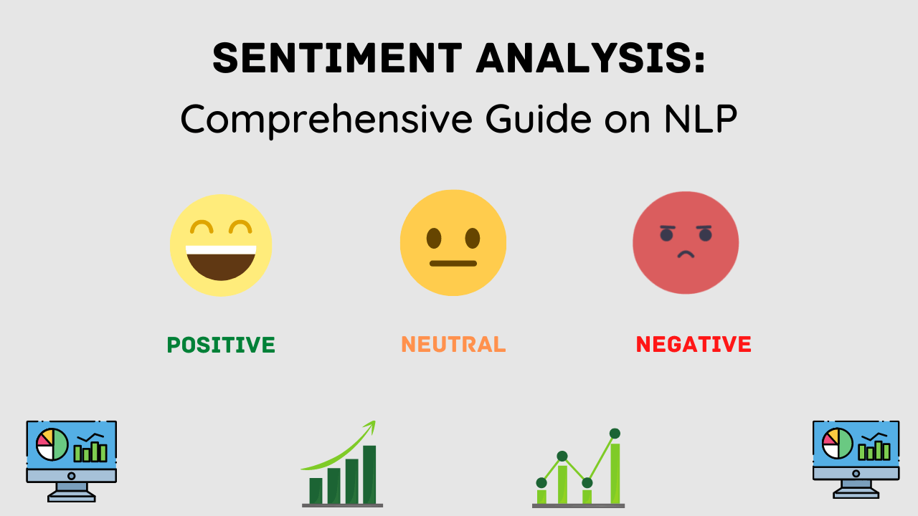

Natural language processing (NLP) = computer science + linguistics + machine learning.
Purpose: making computers understand and generate human language.
Applications: language translation, text-filtering, speech recognition, sentiment analysis, voice assistants and chatbots, auto-correct and auto-prediction, etc.
Intro of NLP
What is Sentiment Analysis?
An NLP technique
Used to determine whether data is positive, negative or neutral from text data.
Extract insightful information & prediction.
Source: https://analyticslearn.com/sentiment-analysis-comprehensive-guide-on-nlp
Source: https://www.shutterstock.com/zh/image-vector/banner-neurolinguistic-programming-nlp-vector-illustration-1257901324

Slide 8


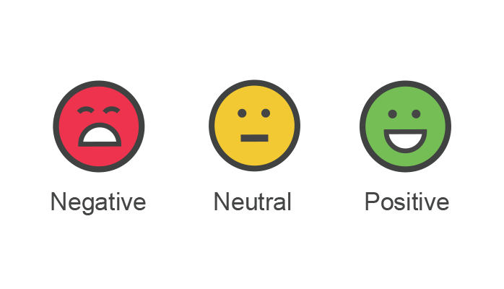
Pros and Cons of Using Sentiment Analysis
Pros
Cons
Automatic and rule-based
automatically gather text
analyze emotional tones by extent.
Quantified attitudes
give sentiment score to each word and sentence
Wide application on social media platforms
analyze audience intent and opinions
Scene limitation of model
-model ≠ multiple domains
Sarcasm Detection
sarcastic text use positive words
Negation Detection
different linguistic rules/ hard to detect
Word Ambiguity
impossibility to define polarity in advance
Multilanguage limitation
lower accuracy for non-English language

Slide 9
Chapter 3
Data Collection
YouTube Data API

Slide 10
YouTube Video Comments
YouTube Platform Benefits:
Official YouTube Account: Targets heavy equipment company official YouTube account
Keywords: Battery, battery-electric truck, hydrogen, hydrogen truck, H2 ICE, Fuel cell truck and other new clean power.
YouTube Video Selecting rules:
Watches: over 10k
Time: In the last 2 years
Number of comments: over 50

Slide 11

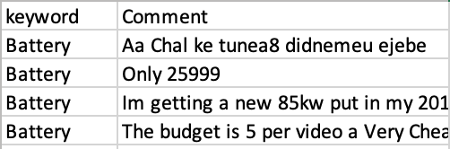
YouTube Data API
YouTube Data APIs:
With the YouTube Data API, we can easily use api-key to get access all the comments of target YouTube videos and transfer those comments as a raw data set.

Slide 12
Chapter 4
Data Cleaning

Slide 13
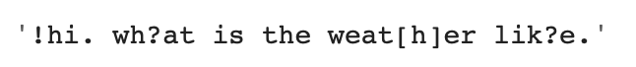
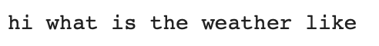
Data Cleaning Steps
Decoding and Encoding
Interpret comments as ASCII code.
Tips: ASCII, stands for American Standard Code for Information Interchange
Remove punctuation:
The punctuation removal process will help to treat each text equally.
Input:
Output:

Slide 14




Remove stopwrds:
Stop words are available in abundance in any human language
Input:
Output:
Remove stopwrds:
Replace emojis into words since emoticons from emojis give strong information
Input:
Output:

Slide 15
Chapter 5
Data Analysis:
Sentiment Analysis

Slide 16
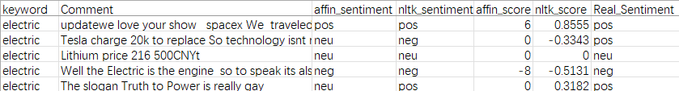
How to do the Sentiment Analysis
Sentiment Analysis Steps
Using words dictionary in package
Calculate the sentiment scores
Total scores > 0, positive sentiment
Total scores < 0, negative sentiment
Sentiment Analysis Steps
Import words dictionary in NLP packages
Calculate sentiment scores
Label the sentiment as positive, negative, neutral
Analysis Packages:
Affin
NLTK

Slide 17
Chapter 6
Data Modeling

Slide 18
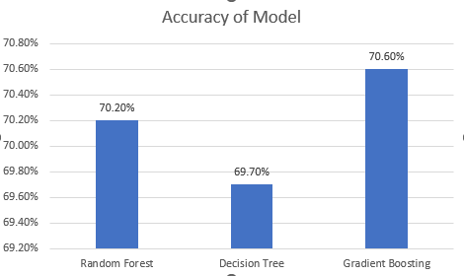
Logistics
Create dummy variables for categorical variables
Label the real sentiment column
Split train test dataset: 70% : 30%
Train and test the classify model with the predict values
Estimate indicators：
Predicted Accuracy
Result:
Classifiers:
Random Forest
Decison Tree
Gradient Boosting

Slide 19
Chapter 7
Data Visualization

Slide 20
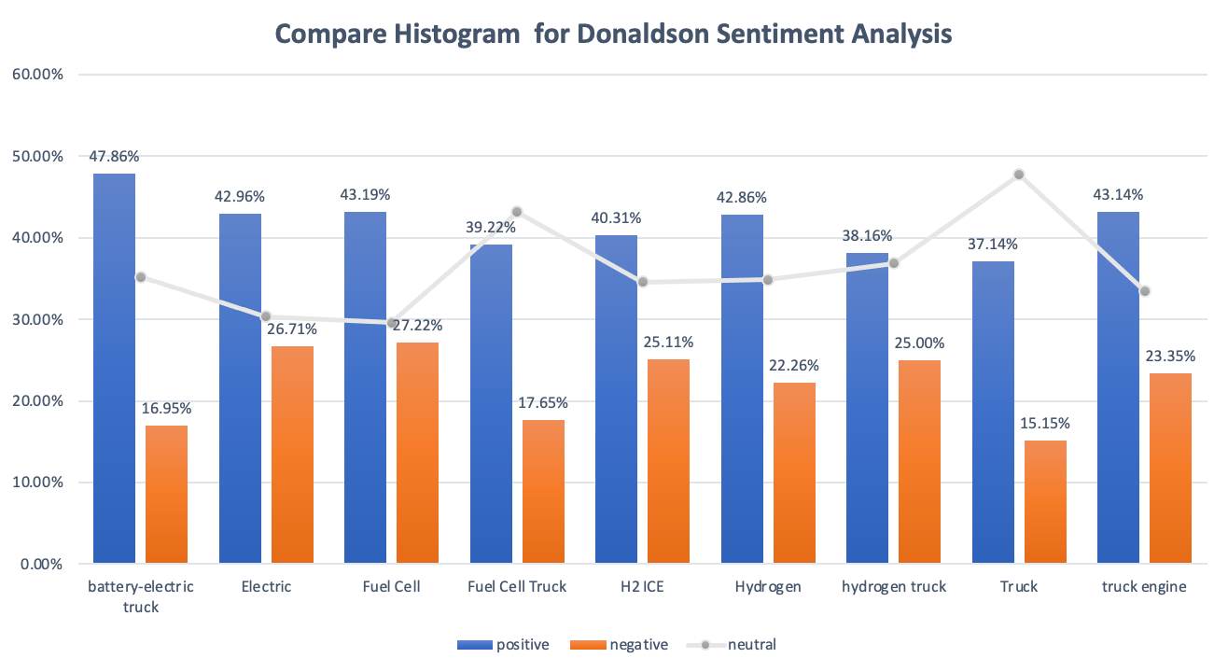
Bar Plot: Keywords Sentiments Comparison

Slide 21
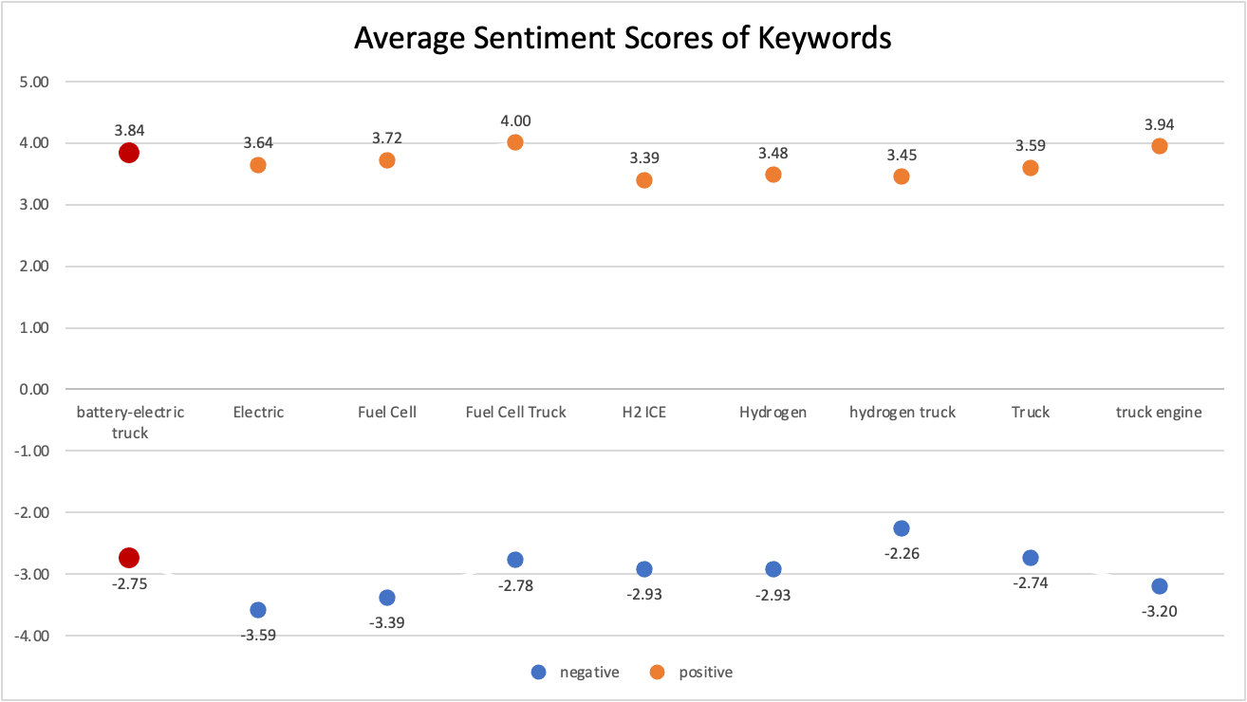

Slide 22
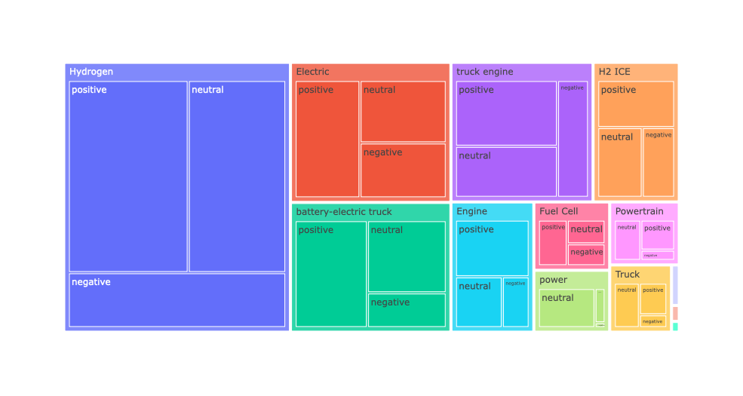
Heatmap

Slide 23
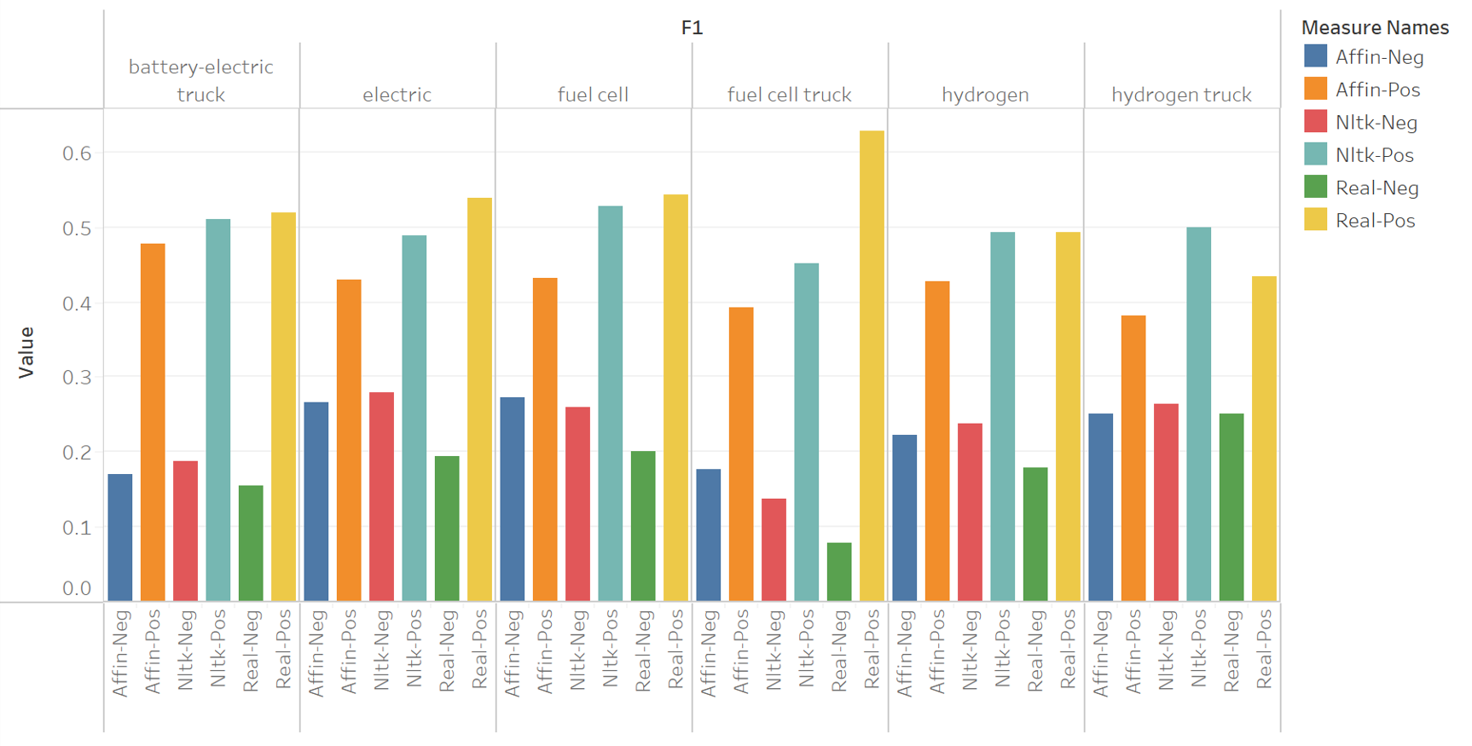
Sentiments Analysis Packages Comparison

Slide 24
Chapter 8
Conclusions & Suggestions

Slide 25
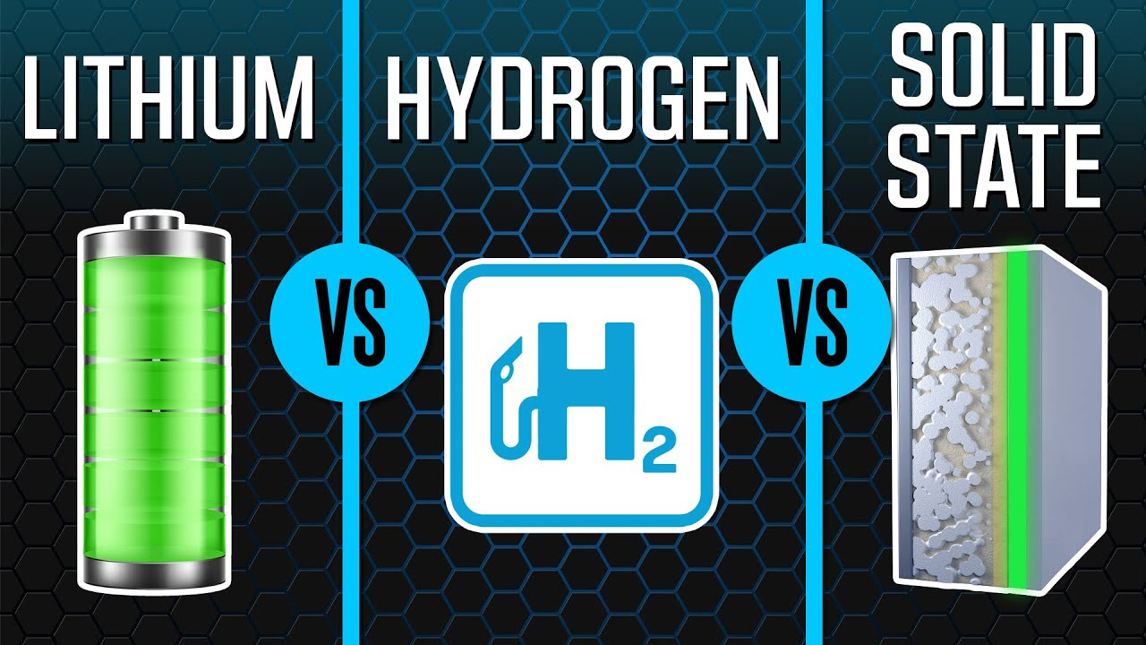
Battery-Electric Powertrain —— the winning technology of powertrain industry in the future.
Battery-electric powertrain has a more positive future.
Hydrogen powertrains and trucks are in a controversial situation.
Battery-Electric Powertrain —— prioritize the development of related filters to occupying the market.
Produce limited hydrogen filters to keep abreast of market changes and effectively making strategic changes.
Conclusions
Suggestions

Slide 26
Chapter 9
Weakness

Slide 27

Weakness
Single python sentiment analysis package
If our team use multiple packages to compare the results, since the criteria and dictionary of each package are different, it will cause the results to be biased
Using data modeling to find the relationship between package outcomes, keywords and real sentiments is of little practical significance
Only social platforms are not enough
Many heavy equipment companies don't have official accounts on YouTube or rarely post YouTube feeds and videos.
Comments on social platforms can only represent for the attitude of some people. And most users are not the companies’ target customers.

Slide 28
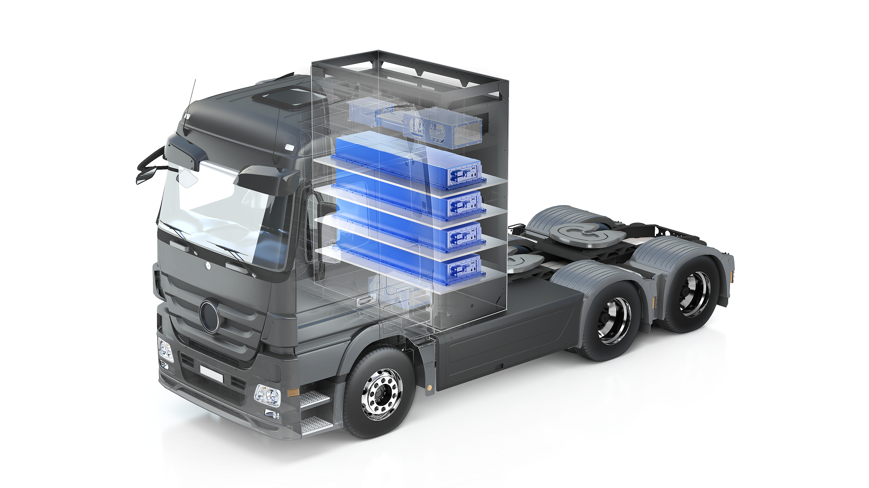
Thank You！

